Slide 1
Zombie School
A Fantastic 4 Production

Slide 2
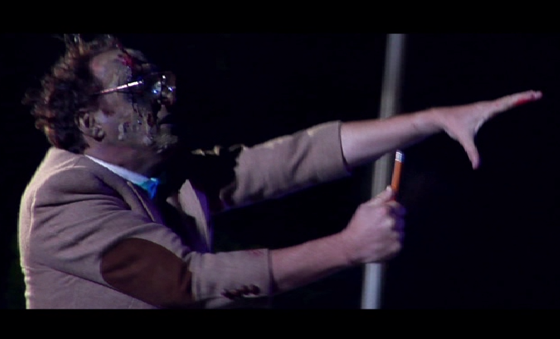
Concept
One day all the teacher lose their brains and turns into zombies. It’s up to you find all their brains and turn them back to normal

Slide 3
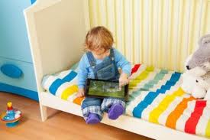
Target Audience
6-12 year olds
English, French, Spanish language localization
Desired platform Tablet.

Slide 4
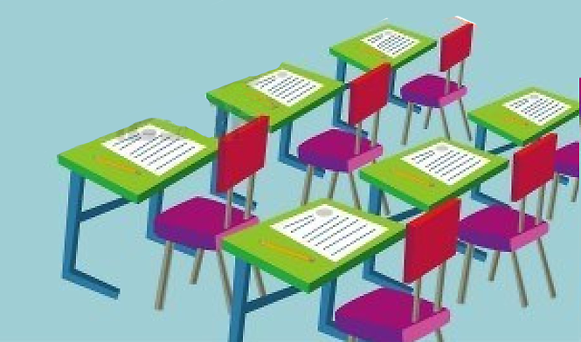
Committed For Last Spring
Animated main character
Physic based puzzle
Jigsaw puzzle
More Rooms
Hallway

Slide 6
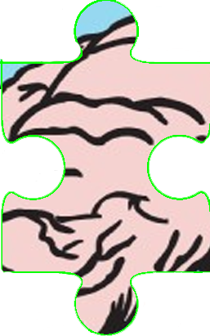
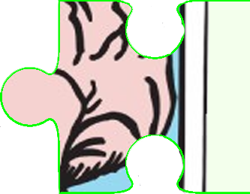
Next Sprint
3 more rooms with puzzle
Make variation of existing puzzles

